Slide 1










Hydrological Pattern Analysis: Rivers & Reservoirs
Low Battery Gang
Team members
Rohan (2022101072)
Aman (2023111018)
Bharath (2022101044)

Slide 2

Problem Statement
River systems and reservoirs are under increasing pressure from both climate variability and direct human activities. However, there is a critical lack of a long-term, integrated understanding of how these drivers translate into physical changes on the ground.
This project will address this gap by using data archive to quantify the dynamics of river channels and reservoir areas, explicitly linking observed changes to climatic trends and anthropogenic pressures like dam construction and land use change.

Slide 3
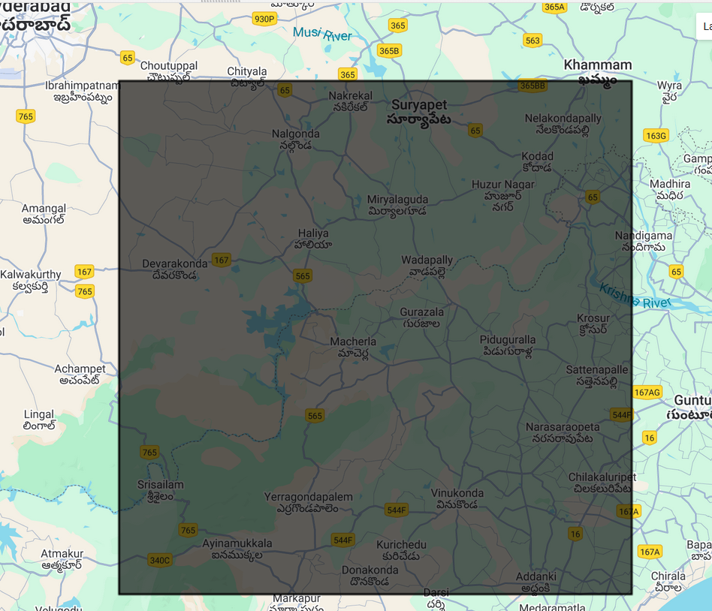
Scope of Project
(AOI)
The analysis focuses on one major river (such as the Krishna River) in the nagarjuna sagara dam and a few key reservoirs within the basin to ensure detailed and manageable evaluation. Seasonal changes between the monsoon and dry periods will be compared to understand fluctuations and hydrolic shifts. The study also examines surrounding land-use changes, such as urban expansion and agricultural encroachment, and relates these spatial patterns to climatic factors like rainfall and anthropogenic influences such as dam construction

Slide 4
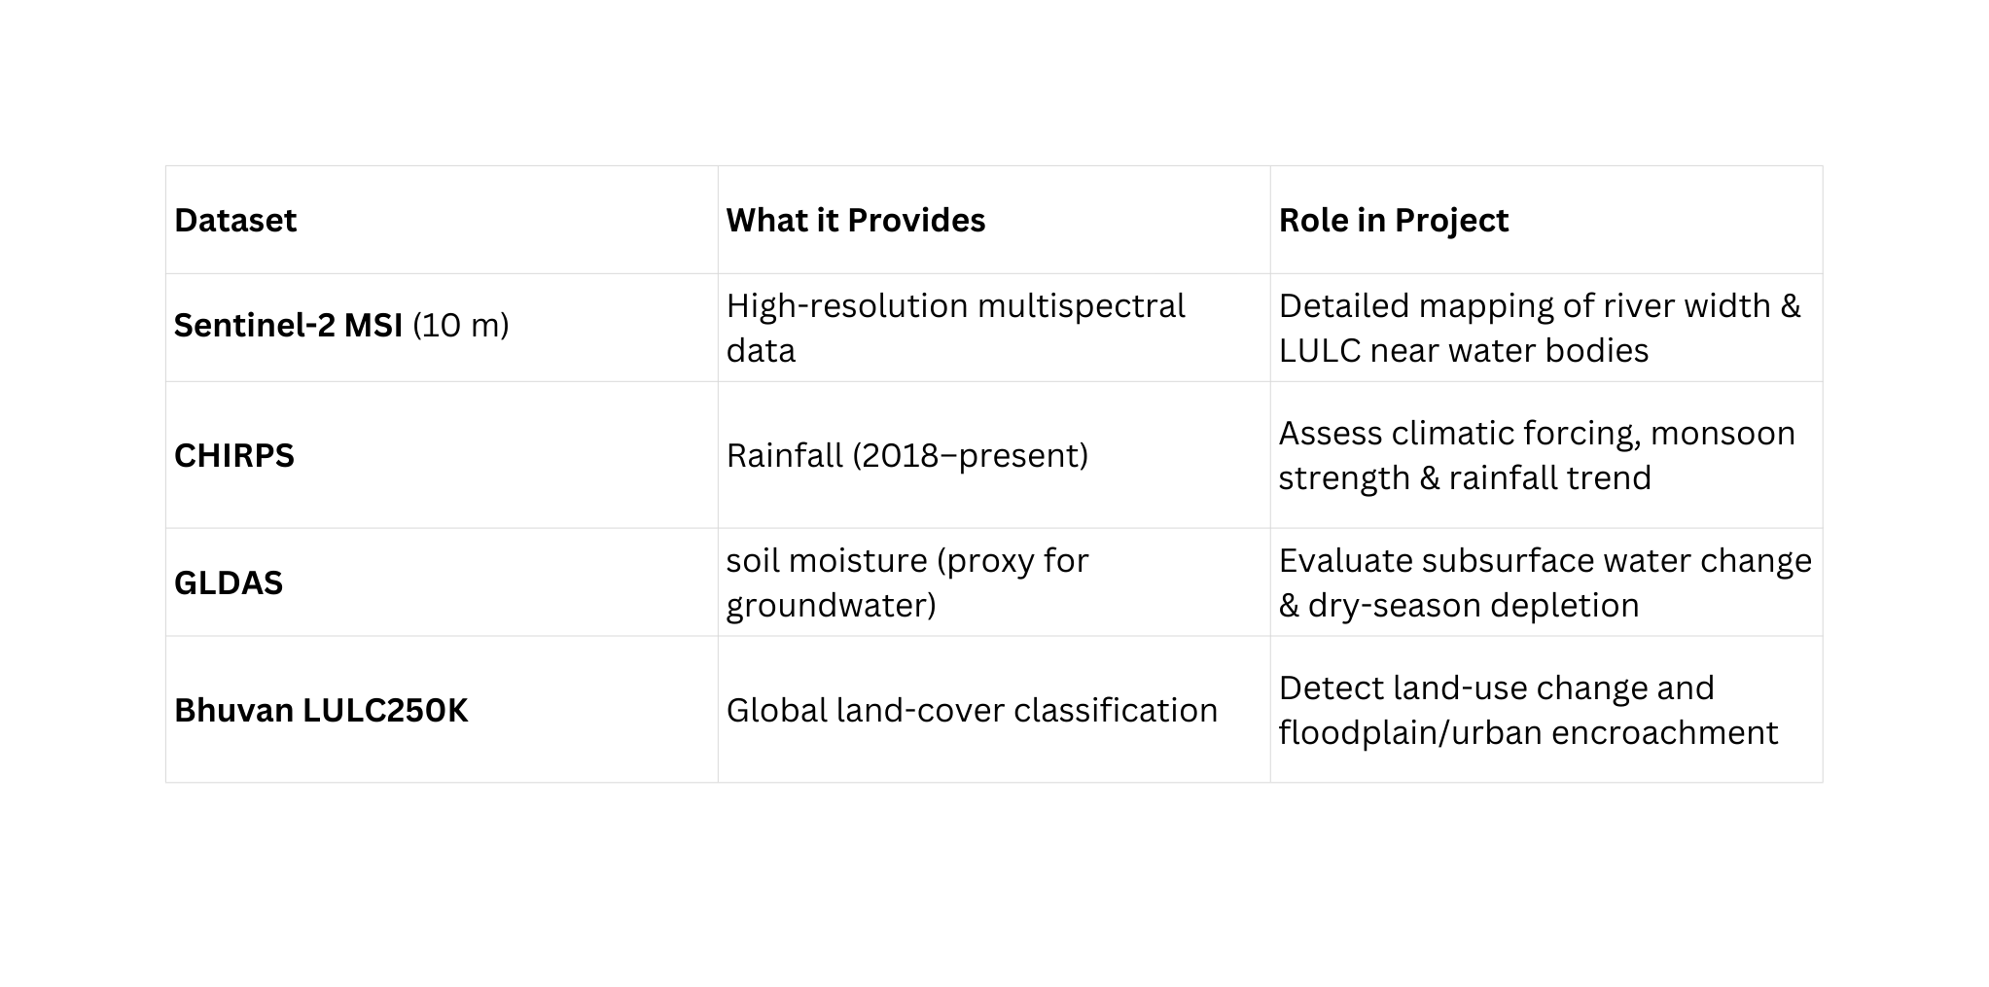
Datasets
Assumption : Soil moisture acts as proxy for ground water, why use soil moisture ? ground water data (GRACE), is of low resolution ~300km, and the GLDAS is of ~25km resolution

Slide 5
Output & Visualization
Thematic Datasets: The collection of all final, analysis-ready outputs. This includes maps of river width, land cover change, and bank migration, as well as time-series data for reservoir area and driver attribution.
Data Packaging: Data is delivered in GeoPackage format for desktop GIS software and as Google Earth Engine assets for further cloud-based analysis. The structure is designed to be easily queryable for specific information (e.g., "Reservoir area in year X").
Visualization Platforms: Refers to the end-user tools, such as interactive web maps or dashboards, that will be used to display the final thematic datasets and analytical results to stakeholders.

Slide 6
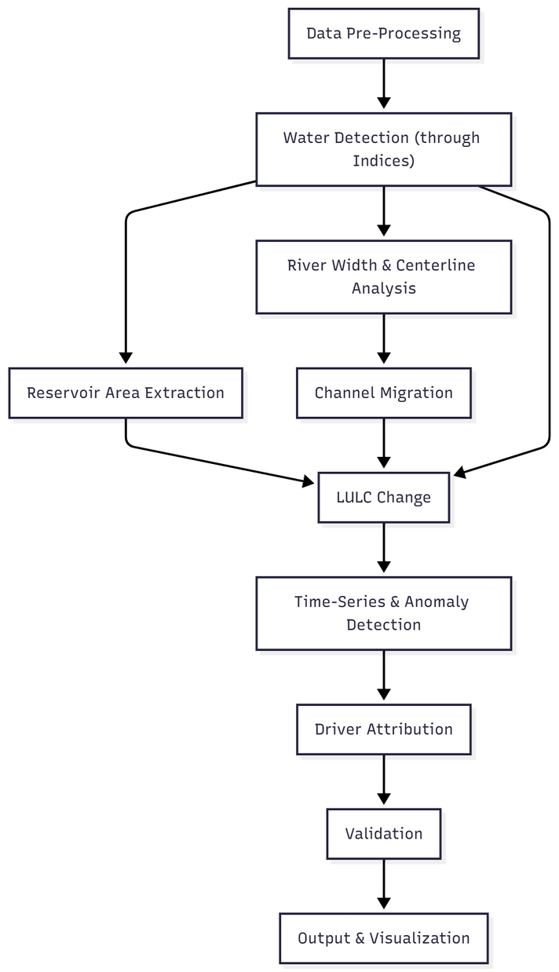
Methodology

Slide 7
Choice of Satellite
Our choice of Satellite was Sentinel-2 even though the Surface Reflectance for the Satellite was only available from April 2017 (effectively making our data points only available from 2018) against our desired starting point from 2015.
This is due to the following 2 reasons:
One limitation of our project was that the Monsoon data at certain points of the data collection got a bit skewed as the Cloud Cover for these months was higher than the dry months, hence the selection of Sentinel-2 was important as it allowed us more data points collection compared to Landsat 8/9 ( Sentinel-2 has a revisit period of 5 days compared to 8 days for Landsat).
Sentinel-2 provides higher Spatial Resolution for our analysis (10m compared to 30m from Landsat 8/9) which is essential as our AOI is only 100kmx100km, so we need higher resolution for analysis.

Slide 8
Water Detection
Spectral Water Indices (MNDWI/NDWI)
The data has been mapped from 2018 to 2025 to observe seasonal as well temporal changes in the AOI.
The seasons included for analysis are Winters, Summers and Monsoon.
Winters: October to February
Summers: March to June
Monsoon: July to September

Slide 9
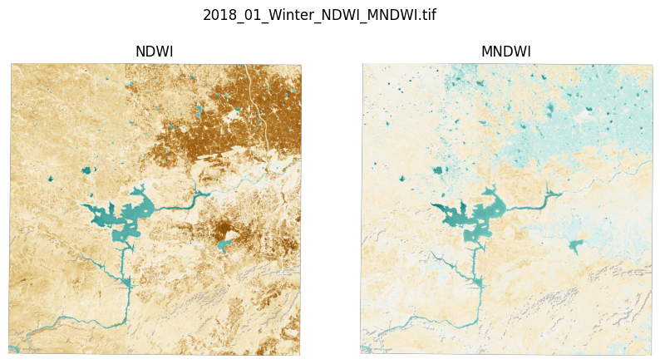
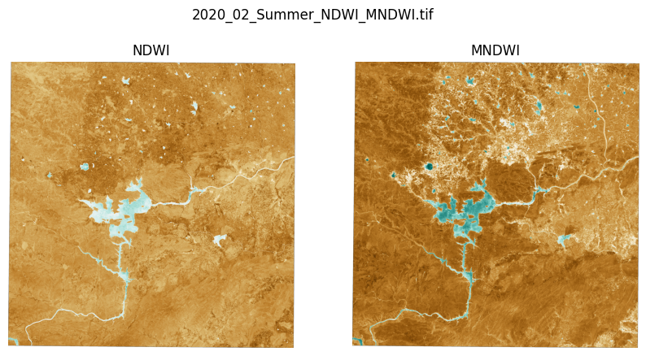
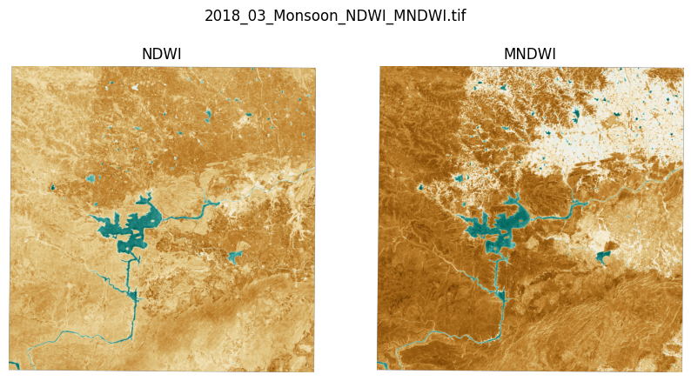
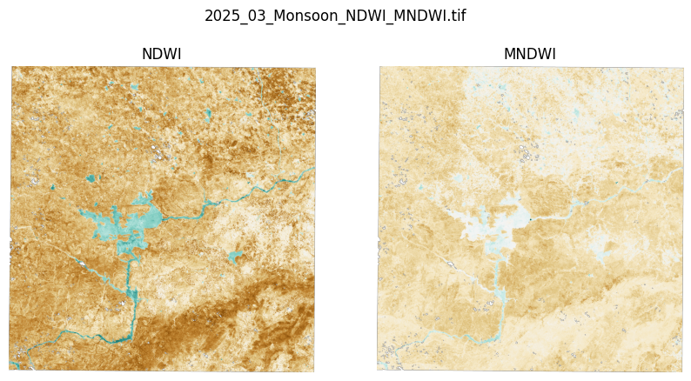

Slide 10
River and Reservoirs Separation
Firstly we need to separate the rivers and reservoirs from each other to extract the proper analysis we require from them( Reservoir Area and River Width Analysis).
The script cleans up the map by ignoring any small, stray water patches (anything under 1 km²), focusing only on the significant water bodies.
Then, it tries to tell the difference between wide reservoirs and the rivers. It does so by shrinking the edges of every water body inwards by x meters.
If a water body disappears completely when shrunk (meaning it wasn’t wide, less than 2x m wide), the script calls it a river.
If a "core" is left over, the script assumes that it is a reservoir.

Slide 11
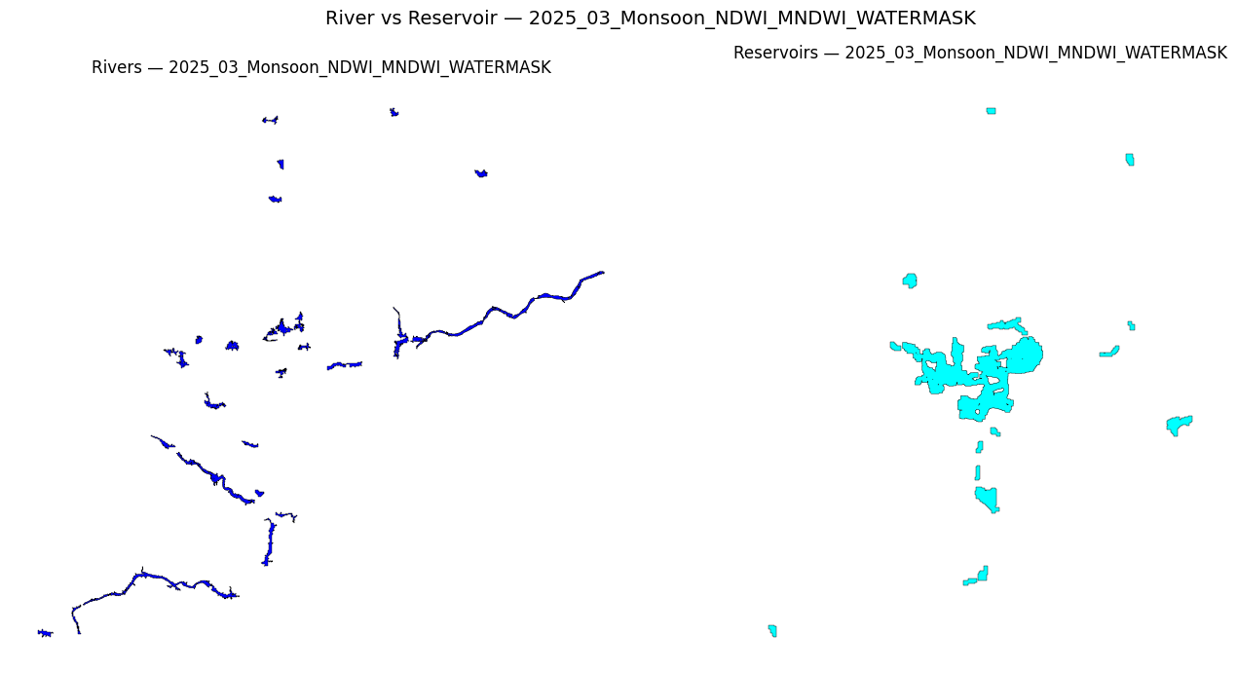

Slide 12
Reservoir Area Extraction
Area Calculation counts the number of water pixels within the clipped reservoir boundary and multiplies by the pixel area (10m×10m) to get the total water surface area in square meters.
Time-Series Generation plots the calculated area for each month/season over the years (2018-2025) to create a graph showing filling/drying cycles and long-term trends.

Slide 13
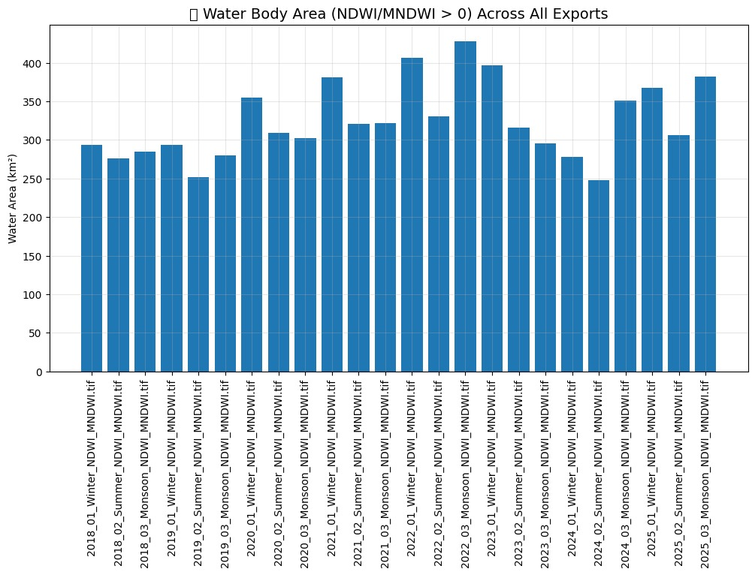
The area for the summers is lowest, which is expected.
The area for winter being slightly higher than Monsoon is also an interesting finding, indicating that the main reservoir (the one feeding the Krishna River) is not at its maximum since there needs to be space for rainwater during Monsoon hence the Dam is opened more frequently than Winters.

Slide 14
River Width Analysis
Uses a simple estimation to calculate average river width of the river from the separated Rivers file. (This file is stored as a shapefile for all the years just so I can extract the main river- Krishna for analysis such as River Width and Channel Migration and Meandering)
The calculation:
Area = Width(w) x Length(l)
Perimeter= 2 x (w + l)
But for a river, w << l
w + l ~ l
Area = w x (Perimeter / 2)
w= 2 x (Area / Perimeter)
This width is an approximation for the average width for the entire length of the river.

Slide 15
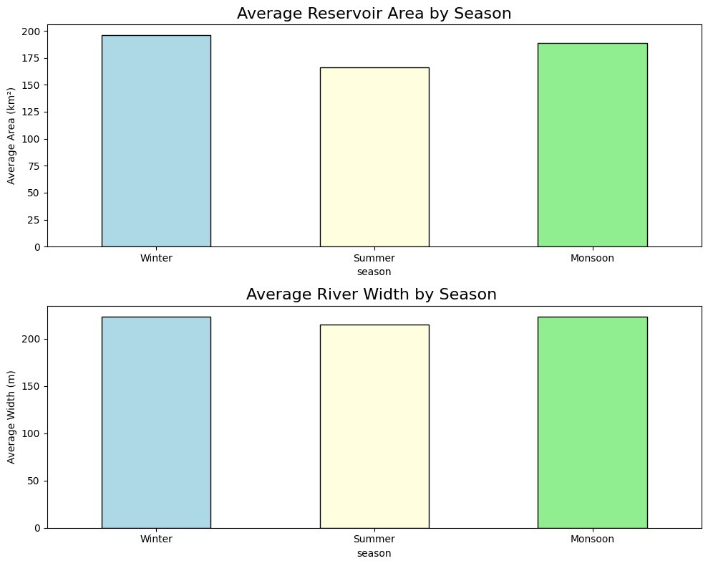
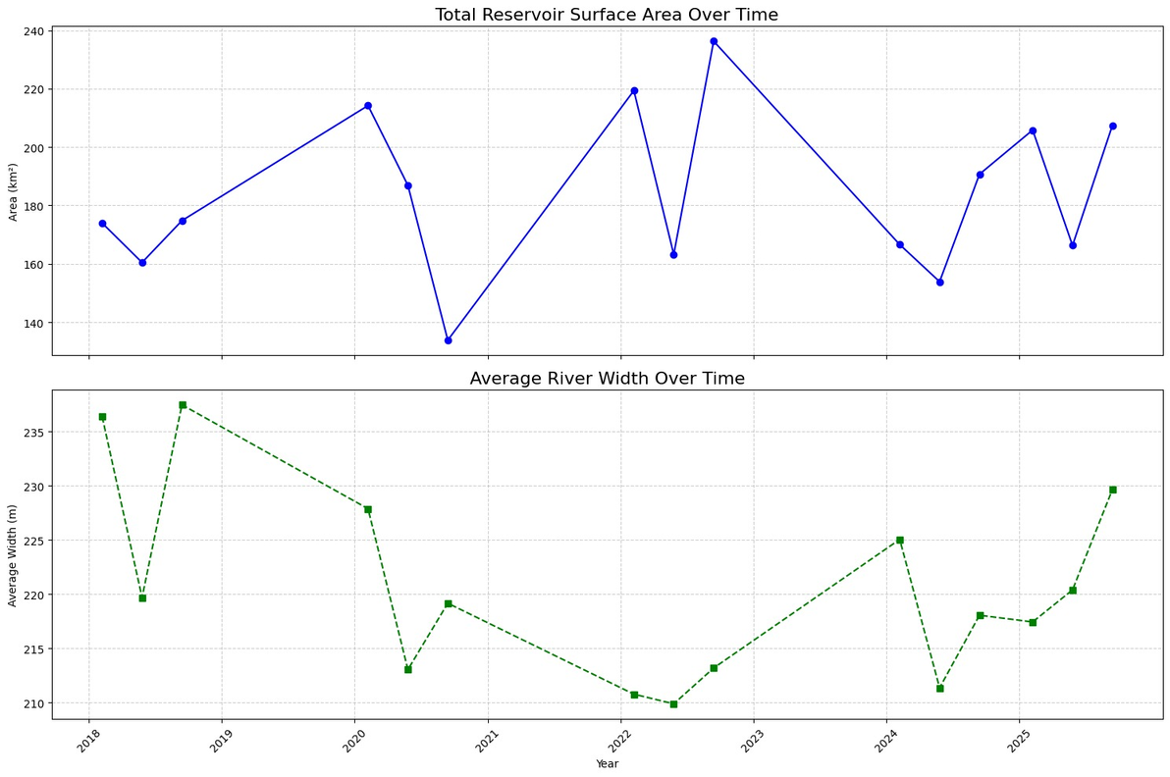
The river width during summers is as expected due to heat and scarce rainfall.
The river width for Winters and Monsoon being almost equal can be attributed to two things:
The higher cloud cover makes the data collection more difficult for the Monsoon season, the years with less cloud cover like 2022 and 2025 are shown to in fact have higher Monsoon River width.
The northeast Monsoons in winters do contribute to the rainfall in the region and is also marked with less sunlight, leading to more river overflowing.

Slide 16
Channel Migration and Meandering
Isolate Channel: Selects and merges the main river channel from each dataset based on an X-coordinate threshold.
Extract Centerline: Approximates a centerline by sampling 500 points along the outer boundary (perimeter) of each river polygon.
Calculate Migration: Computes local migration rates (in m/year) by finding the minimum distance from each 2020 boundary point to the 2025 boundary and dividing by the 5-year time interval.
Analyze & Visualize: Calculates deviation metrics and generates a plot showing the river overlay.

Slide 17
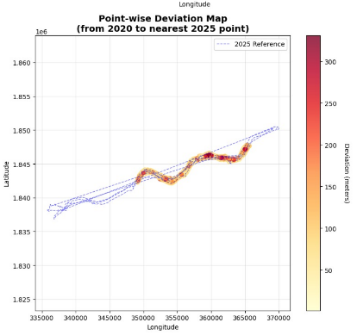

Slide 18
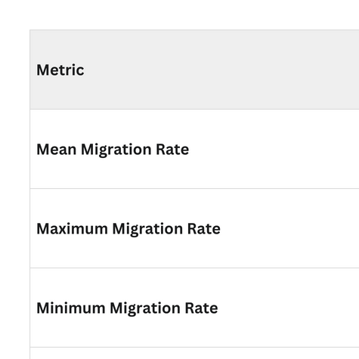
The migration rate of 20m/year while being on the higher side compared to the 16 m/year trend (160m migration from 2010 to 2020) is still within reasonable range.
The rate is highly dependent on the hotspots its measured at . its more difficult to change course at rocky, steep banks compared to banks composed of soil or ones which are smoother.

Slide 19
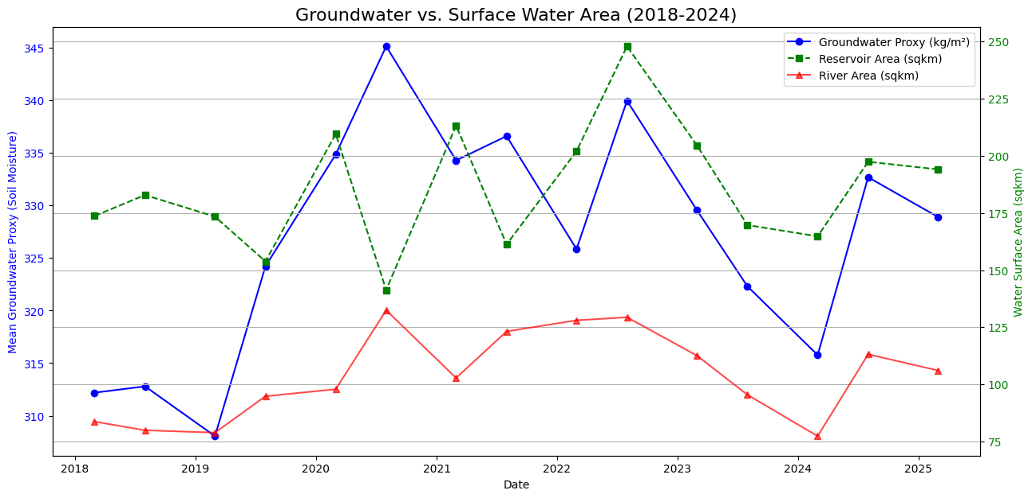
Groundwater vs. Surface Water Area
All three datasets (Groundwater, River Area, and Reservoir Area) are clearly interconnected. They peak together during the monsoon and hit their lows together in the dry season.
The reservoir area (green line) and the groundwater proxy (blue line) track almost perfectly. This suggests reservoir levels serve as an excellent visual proxy for the health of the entire basin's water storage, including the invisible groundwater.

Slide 20
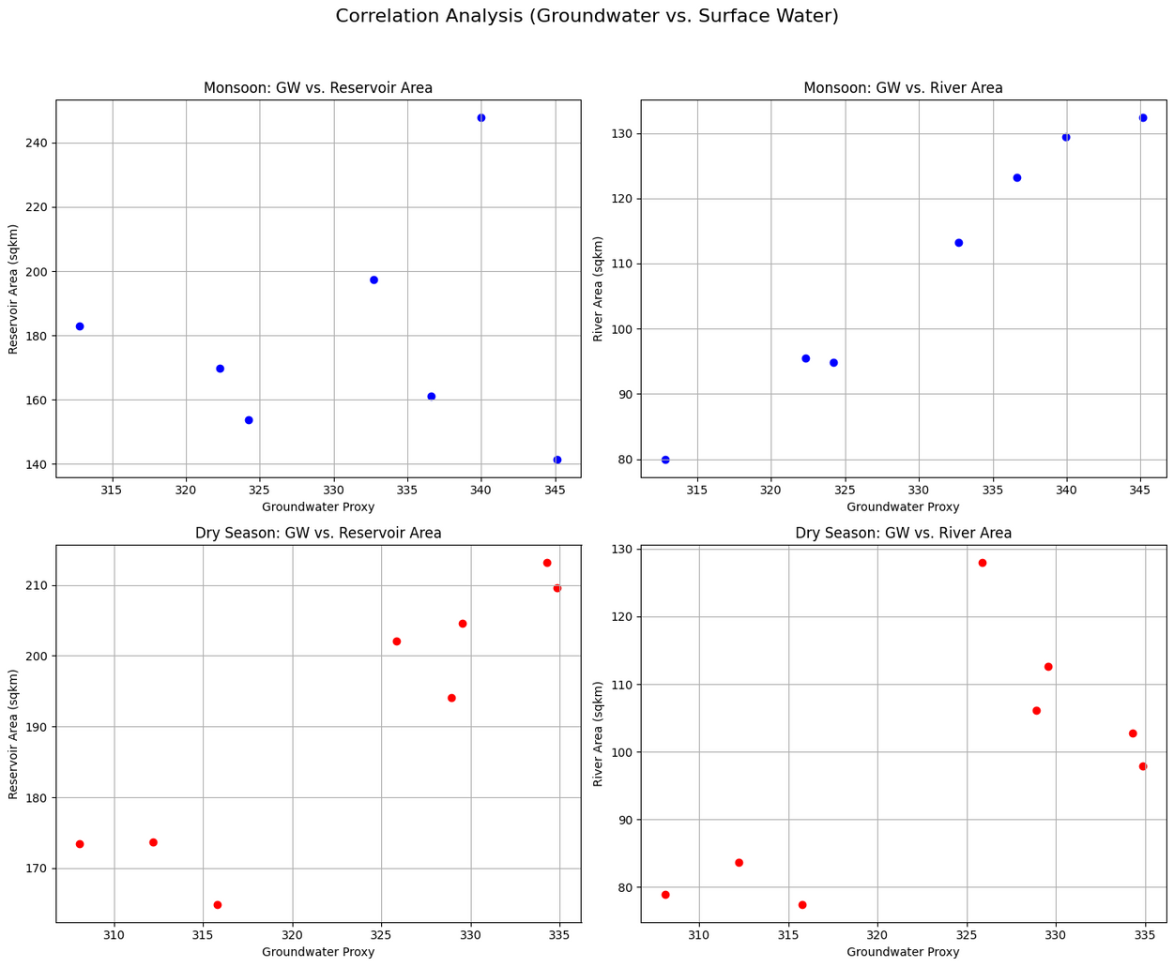
Groundwater vs. Surface Water Correlation
In all four scenarios (Monsoon/Dry vs. River/Reservoir), the trend is "up and to the right." This confirms that in any given season, higher groundwater levels are associated with larger river and reservoir areas.
The "Dry Season" plots are the most critical. They show that even in the driest months, years with higher residual groundwater have wider rivers. This is direct evidence of groundwater's role in providing baseflow and sustaining the river.
This data directly links groundwater to "river width changes." A year with low groundwater (bottom-left dots) will result in a narrower, more stressed river channel, which has implications for erosion and ecology.

Slide 21
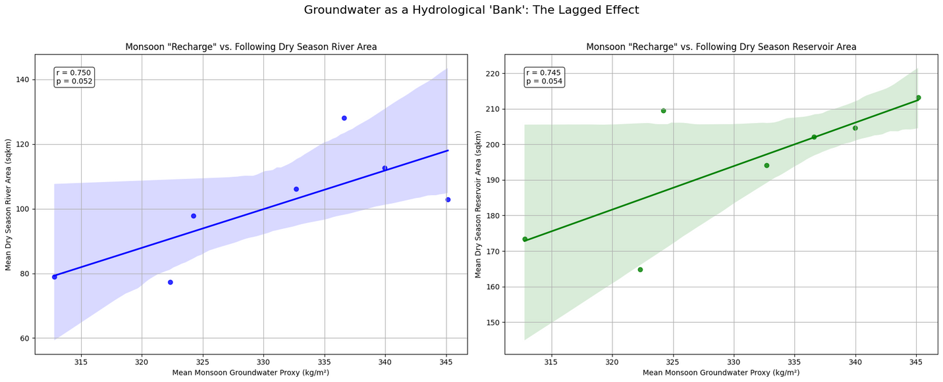
Lagged Effect
The strong positive correlations (pearson r = 0.75 for rivers, r = 0.74 for reservoirs) confirm the "hydrological bank" hypothesis. The amount of groundwater "recharged" (deposited) during the monsoon is a strong predictor of river and reservoir size during the following dry season.
This lagged relationship is a key finding. It demonstrates that you can use Monsoon groundwater data to help forecast the severity of the next dry season's water availability and potential stress on river width.
This plot proves that any project that increases groundwater recharge (e.g., check dams, rainwater harvesting) will have a direct, measurable, and positive impact on keeping rivers and reservoirs fuller during the critical dry months.

Slide 22
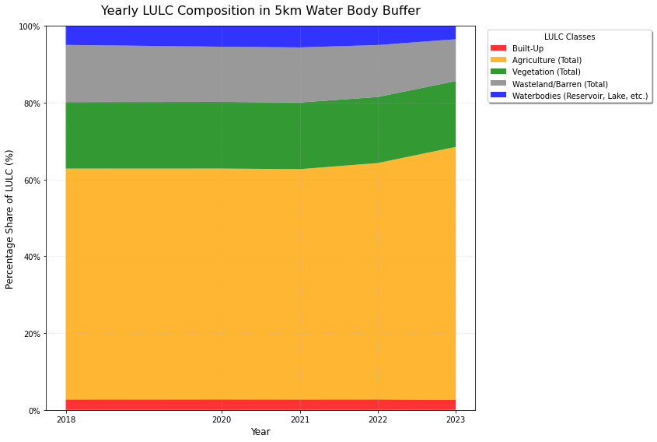
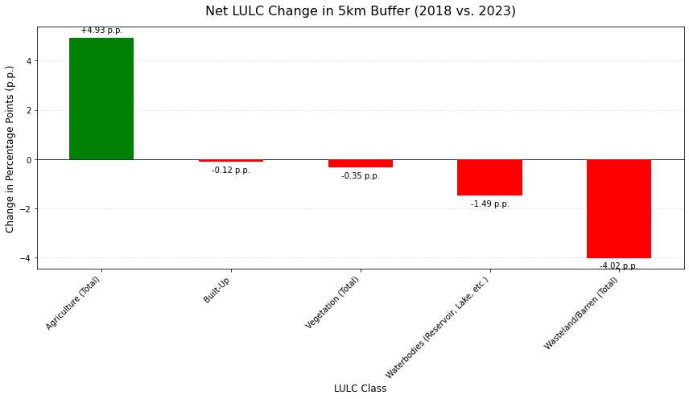
LULC Changes
The dominant trend was a significant +4.93 percentage point (p.p.) increase in Agriculture.
This agricultural expansion corresponds directly with a -4.02 p.p. decrease in Wasteland/Barren land, indicating large scale land conversion.
Agriculture is the primary land use in the buffer (ending at ~68% in 2023), with Vegetation (~17%), Wasteland (~10%), and Built-Up (<3%) remaining relatively stable in their total share.

Slide 23
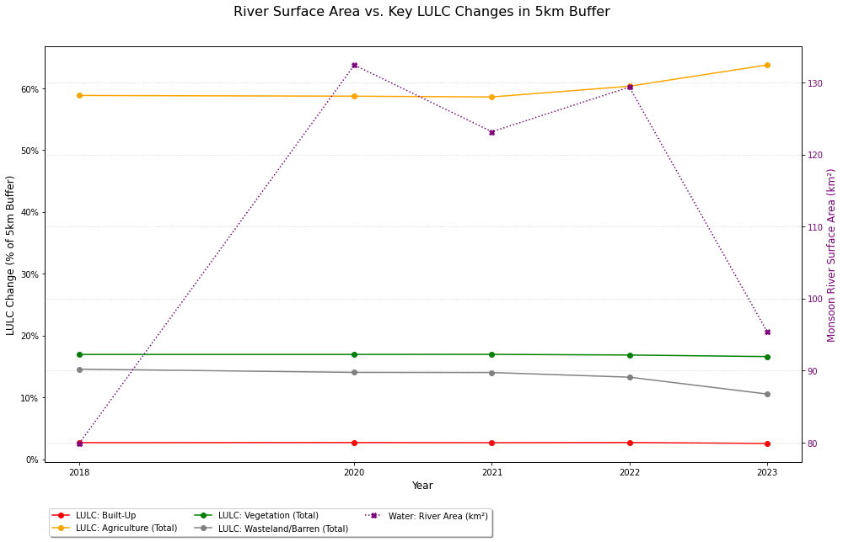
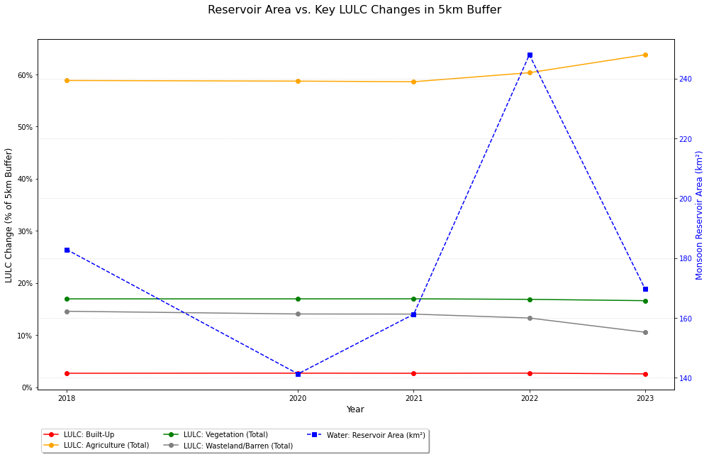
LULC vs. Hydrological Variability
Both the River (purple) and Reservoir (blue) show extreme annual fluctuations, likely driven by variable monsoon rainfall.
In sharp contrast, LULC changes are slow and linear. Agriculture (orange) steadily increases while Wasteland (grey) steadily decreases every year.
This divergence shows that long term, planned human activity (agricultural expansion) is the primary driver of landscape change, not a short term reaction to how much water is available in any single year.

Slide 24
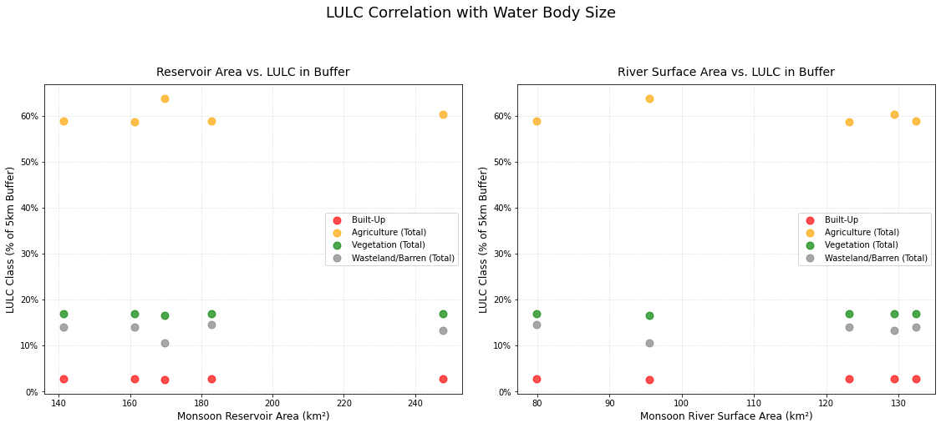
LULC Correlation with Water Body Size
These scatter plots confirm the time-series analysis. There is no strong, direct correlation between the size of the water body (x-axis) and the percentage of LULC classes (y-axis) in any given year.
LULC classes remain clustered in stable percentage bands. For example, Agriculture (orange dots) stays between ~58-64%, regardless of whether the river/reservoir area is at its minimum or maximum.
Conclusion: This reinforces that LULC change is a long-term driver (e.g., agricultural policy, development) and not a short-term effect that reacts to water availability.

Slide 25
Variation with respect to rainfall trends
Season-wise Pearson Correlations
Season | River width | Reservoir Area
Monsoon | -0.635335 | -0.063026
Summer | 0.181305 | 0.031049
Winter | 0.173176 | 0.84044

Slide 26
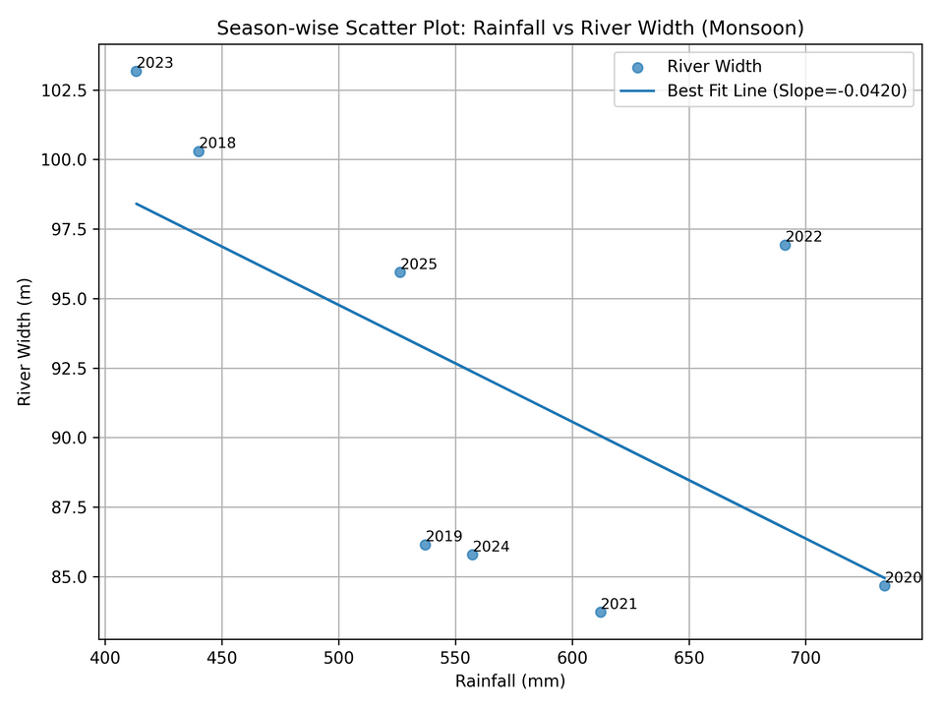
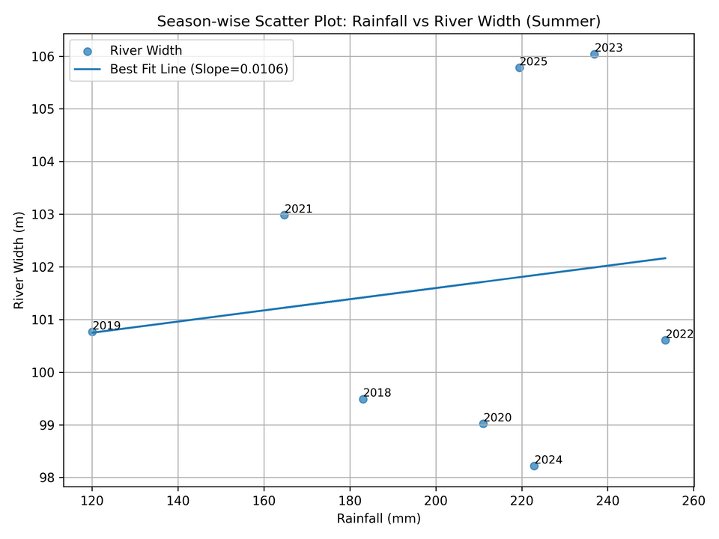
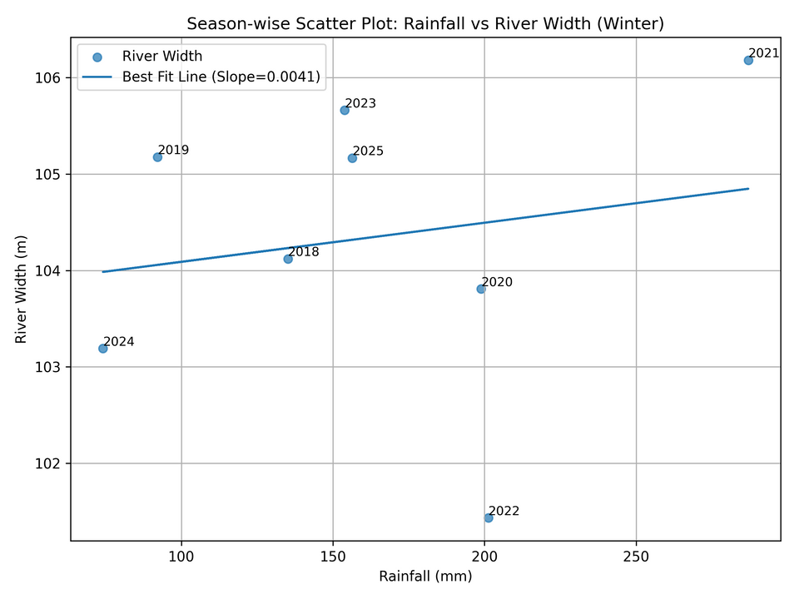
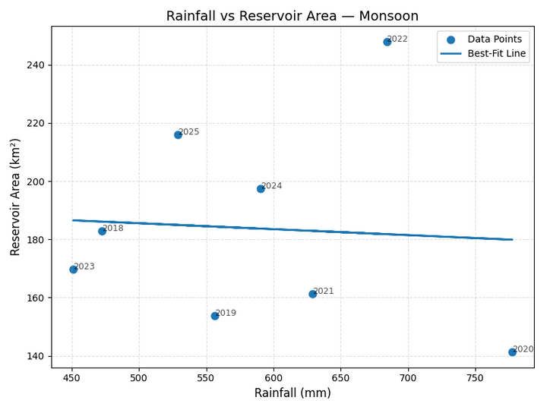
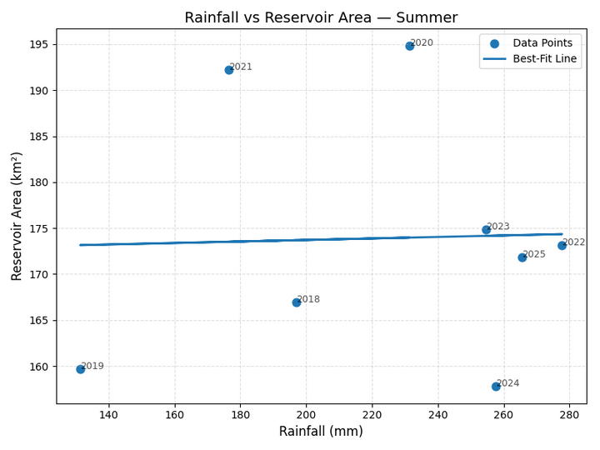
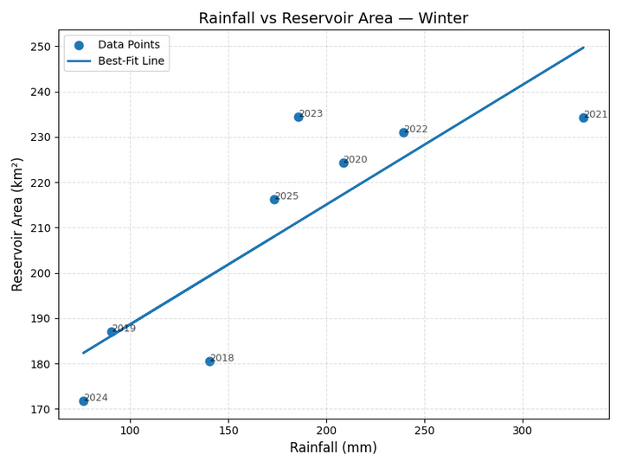

Slide 27
Monsoon
Rainfall vs River Width (–0.64): Higher monsoon rainfall may reduce mapped river width because the channel may already be saturated and spillway operations may control flows.
This may be also due to improper detection of water bodies because of cloud masks while retrieval from sattelites
Rainfall vs Reservoir Area (–0.06): Reservoir area may show no change since it may already be near full level and extra inflow may be released immediately.
Summer
Rainfall vs River Width (0.18): River width may not respond to rainfall because summer flows may be dominated by dam releases and irrigation withdrawals.
Rainfall vs Reservoir Area (0.03): Reservoir area may not correlate with rainfall because evaporation and water demand may offset any rainfall gains.
Winter
Rainfall vs River Width (0.17): River width may show weak correlation because small winter inflows may not significantly alter channel geometry.
Rainfall vs Reservoir Area (0.84): Reservoir area may increase strongly with rainfall because winter inflows may directly fill storage when the reservoir is below capacity. Not much effect of evaporation and excess rainfall too

Slide 28
Decadal trends
Before 2012, we used Landsat 5, but after 2016, we were using sentinel-2. Both satellites may have difference in detection of waves(Due to failure of Landsat 6 & 7)
So with available data, we will consider total reservoir area change
 | Year | Reservoir_Area_km2
0 | 1995 | 277.898402
1 | 2005 | 339.744787
2 | 2015 | 400.254471
3 | 2025 | 512.282817

Slide 29
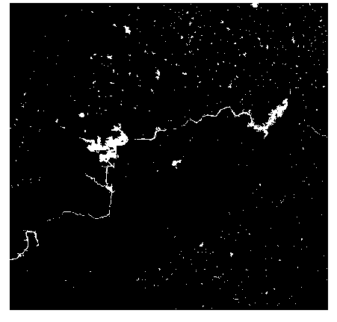
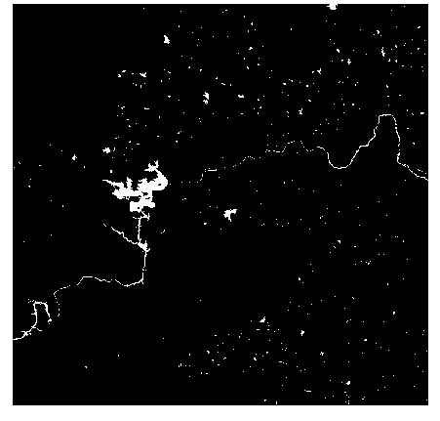
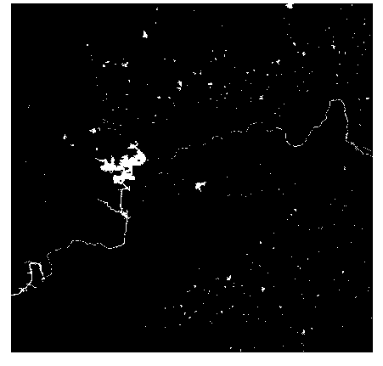
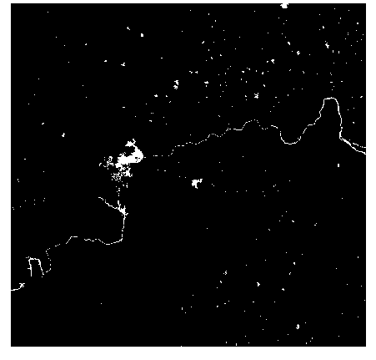
2025
2015
2005
1995

Slide 30
Conclusion from decadal trends
Higher carry-over storage
Reservoir operators now retain more water after the monsoon to meet increasing irrigation, urban drinking water, and hydropower demands, resulting in a larger dry-season water spread.
Stronger upstream regulation
The Krishna cascade and newer downstream structures and the tail-pond have improved flow regulation, allowing Nagarjuna Sagar to maintain a more stable water level in the dry months.
More intense monsoon events in recent decades
High-intensity rainfall years provide larger inflows, so the reservoir often enters the dry season with higher end-of-monsoon storage, increasing the mapped water area.
Improved canal efficiency and modernization
Canal lining, modernization of distribution systems, and better scheduling have reduced water losses, meaning less drawdown is required, leaving a larger dry-season surface area.
Remote sensing improvements (minor effect)
Newer sensors and MNDWI methods can detect shallow and fringe water more accurately, slightly increasing the mapped water area in recent decades.

Slide 31
Modifications Implemented ( Based on Mid Submission Feedback)
We refined our AOI to be along a part of a river rather than its entire length and instead focused on areas with major rivers and reservoirs.
Directly using Satellite Data to calculate River Width rather following the centreline method mentioned in our Mid Submission.
Used LULC from Bhuvan directly instead of training a classifier.

Slide 32
Limitations
The project used reservoir area as an indirect measure of how much water it can hold, however natural reservoirs can widen at the bottom, making it hard to predict just through Surface Area whether it has higher or lower volume.
The biggest hindrance throughout this project was during Monsoon Analysis as the data has high cloud cover, causing it to large gaps in its data.
The indices NDWI/MNDWI are not perfect representations of the water bodies as it can sometimes look past the shallow, sediment rich water on the banks, which can be significant.

Slide 33
Incomplete Objectives
Effects related to dam constructions:
Since many dams were constructed during era of independence in this basin, it was difficult to compare before and after effects of construction
Full decadal trends:
Due to failure of LANDSAT 6 and LANDSAT 7(missing data errors), We had to take only landsat 5 data, which may not give as good resolution when compared to current sattelites. Therefore proper decadal trends may not provided for other parameters
Complete analysis of the last 10 years (2015-2025) was not available due to Sentinel-2 having data only from April 2017 which caused us to refine our window to 2018-2025.

Slide 34
Future Directions
Build a predictive model to forecast future river migration paths and reservoir levels based on climate and land use change scenarios.
Developing a flood risk map by combining the historical water extent data with population and infrastructure layers to quantify vulnerability.
Create a qualitative/quantitative to determine the exact percentage of hydrological change caused by specific drivers (e.g., rainfall vs. dam construction).

Slide 35
•Debnath et al., 2023
–LULC dynamics in Brahmaputra River basin
–Integration of geospatial and statistical methods
References

Slide 36
Thank You

